Slide 1
Getting Stronger
Elections and Candidate Support
Letters to the Editor g

Slide 2
TABLE OF CONTENTS
Introductory Comments……….………………….....................................................3
Letters to the Editor: Coordination……………………….......................................4
Letters to the Editor: Recruitment………………………..........................................5
Letters to the Editor: Support…………………………..............................................6
Letters to the Editor: Resources……………………………………………………….7
Letters to the Editor: NHDP Resources……………………………………………….8
ewee

Slide 3
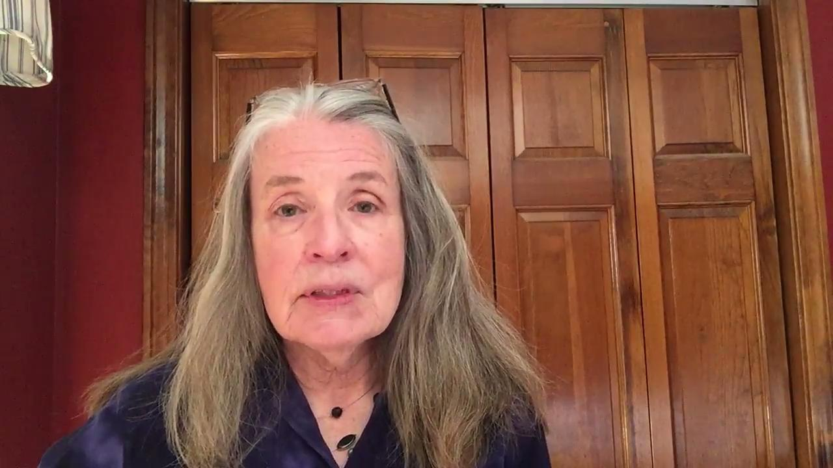
INTRODUCTORY COMMENTS

Slide 4
It is helpful to have a designated person to coordinate LTE efforts.
Recruiting letter writers
Providing them with pertinent information
Maintaining a record of submitted/published letters
Monitoring topics/issues addressed
Planning scheduling for constant exposure throughout the campaign
Posting letters to social media accounts to expand reach beyond newspapers alone
Letters to the Editor: Coordination

Slide 5
Consider a variety of individuals with voices to appeal to voters.
People who have written letters for candidates in the past
Local leaders & experts on specific issues of concern
Individuals who can speak to endorsements from groups like SEIU, NEA-NH, Sierra Club, etc.
People who can speak to a candidate’s personal and/or professional qualifications for the office
Strive for representation from every town/community across the district
Letters to the Editor: Recruitment

Slide 6
Letters to the Editor: Support
The more letter writers know, the more informative letters will be.
Provide contact information/addresses for multiple outlets
Clarify guidelines for submission for each outlet (deadlines, word limits, etc.)
Share candidate background information (campaign literature, website, facebook & LinkedIn pages, etc)
Encourage communication with candidate or designated contact to clarify questions
Provide factual resources for issue-specific letter writers

Slide 7
Letters to the Editor: Resources
“How to Write Letters to the Editor That Really Get Attention.” This article offers good basic information and has useful tips for “getting under the skin” of opponents and holding them accountable. https://indivisible.org/resources/write-letters-editor-really-get-attention
ACLU “Letters to the Editor: How to Write Them and Why They Work.” Succinct article on general advocacy and basics of effective LTEs. https://www.aclu.org/other/tips-writing-letter-editor
ACLU “Tips on Writing to Your Elected Officials” provides guidance on brevity, focus and how to personalize letters that can be adapted to LTEs. https://aclu.org/other/tips/writing-your-elected-officials

Slide 8
Letters to the Editor: NHDP Resources
The NHDP website provides information about area newspapers and a guide useful “Letter Writing Tips:”
“Write a Letter” allows you to enter your contact information and zip code to generate a list of newspapers in your area.
“Letter Writing Tips” provide helpful information on choosing a topic, having a goal, use of specifics and local/personal stories as well as checking for word limits and mistakes. https://nhdp.org/write-a-letter
“2021, 2022 and Beyond: A Local Committee Manual” also provides New Hampshire Democratic Committees with “Letters to the Editor (LTE)” information and suggestions for forming letter writing groups.

